Slide 1


CASE STUDY
Osteoarthritis and its increasing risk of Cardiovascular Disease
Tanisha Sabhaney, Nina Wang, Neerja Singh, Alexander Binder, Angela Chou and Viraj Deshpande
THE DATAVADERS
Notes:
Good Morning everyone! I am Nina, and they are my fellow teammates. We are the data vadars
The case we are going to share today is about Osteoarthritis and it’s increasing risk of cardiovascular disease based on the data from Canadian Community Health Survey

Slide 2


CARDIOVASCULAR DISEASES
IN CANADA
OSTEOARTHRITIS
IN CANADA
2.4 Million Canadians are affected by heart diseases.
The older population is more likely to be affected by Cardiovascular Diseases.
Osteoarthritis is the degeneration of the joint cartilage and the underlying bone.
4.6 Million Canadians are affected by Osteoarthritis and the number is expected to rise in the future.
The growing concern:
Osteoarthritis increases risk of developing cardiovascular diseases.
THE DATAVADERS
Notes:
According to the study 2.4 million canadians are affected by heart diseases.
More commonly, 4.6 million canadians are suffering from Osteoarthritis. the number is expected to rise in the future, rapidly growing, ageing populations.
Although much studies have been done with the risk factors of Cardiovascular disease, like diabetes and hypertension, the interrelationship between osteoarthritis and CVD and their shared risk factors are still under discussion.
Our Team tried to clarify these questions based on the data from Canadian Community Health Survey and offer suggestions for how to raise public awareness on the topic.
Here is what we find.

Slide 3
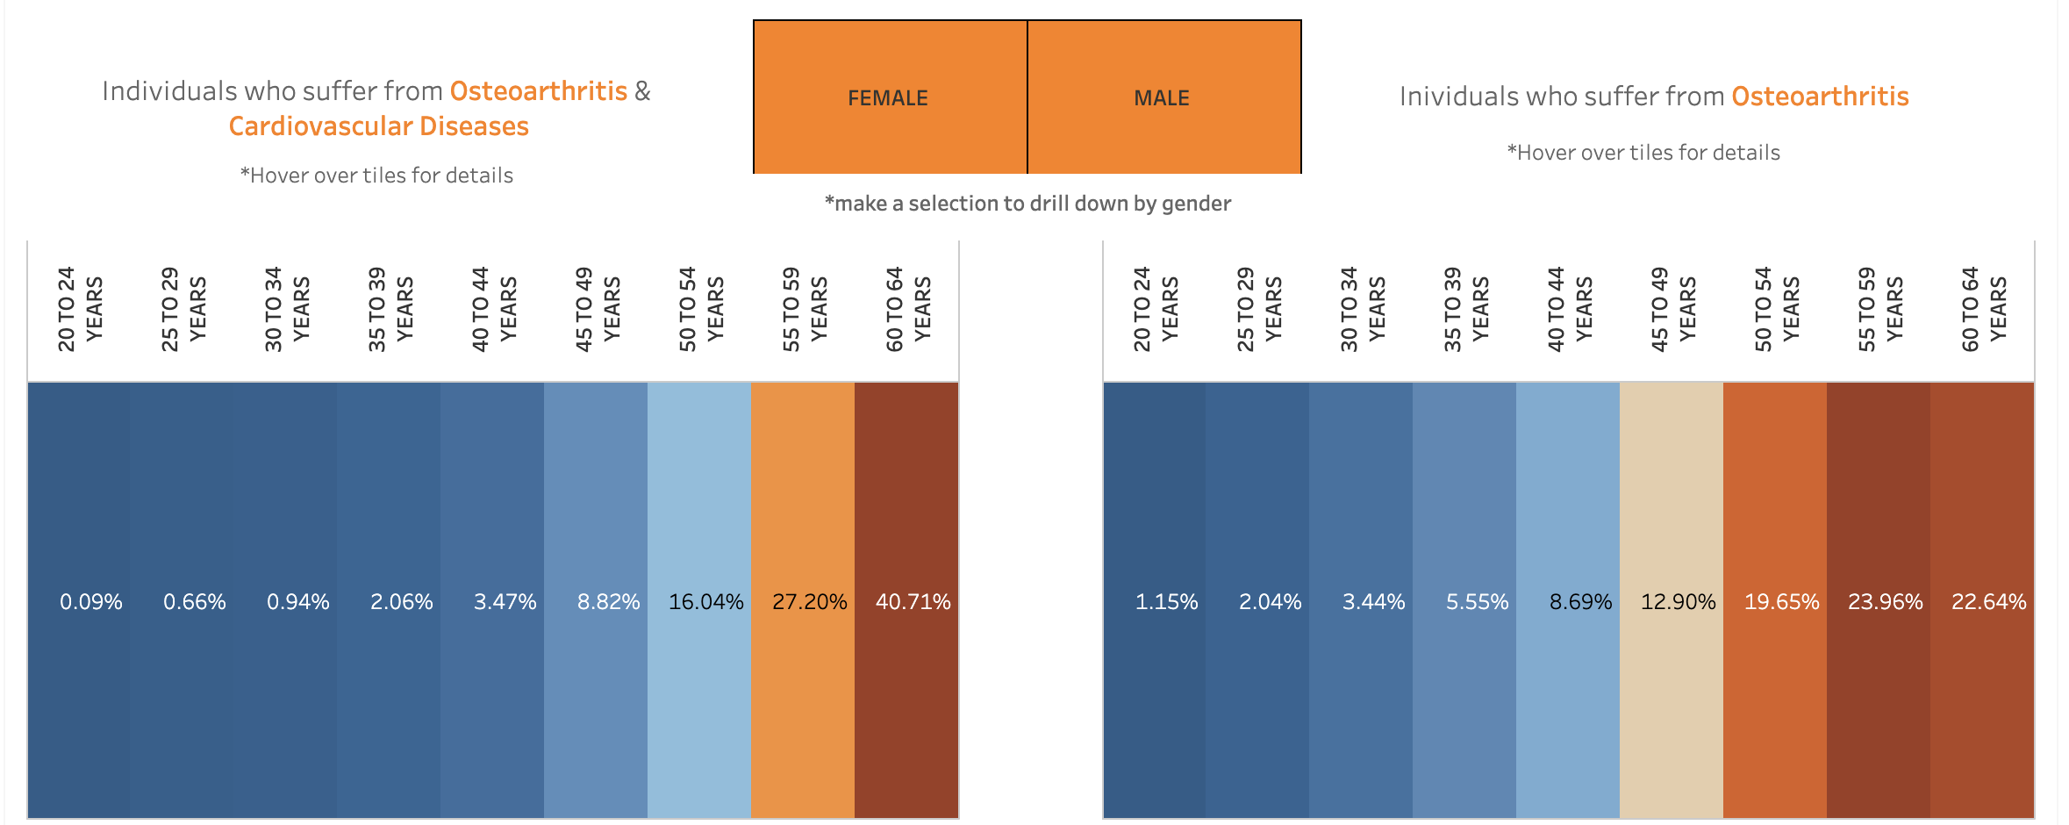
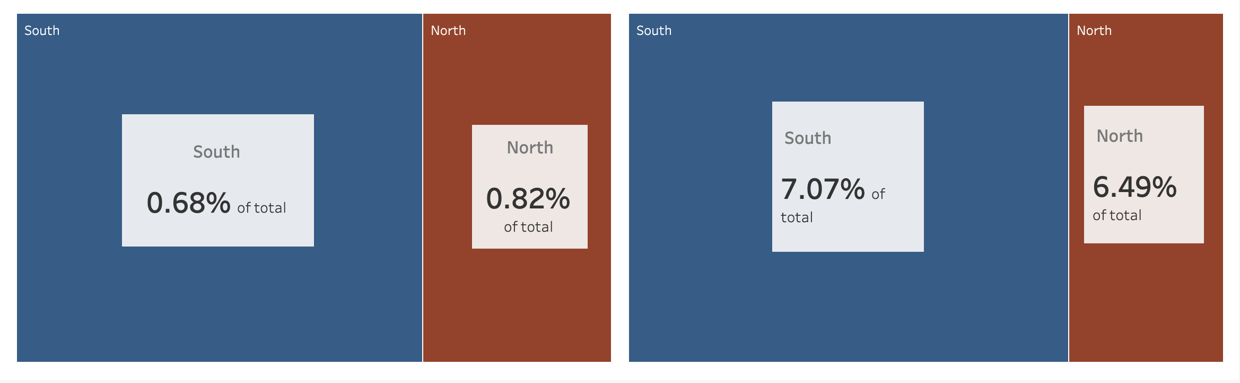

Slide 4



https://tabsoft.co/2ri3qp6
THE DATAVADERS

Slide 5
MODERATORS
Gender
The odds of developing CVD is 14% higher among women with OA than men with OA.
Geographical Location
The odds of developing CVD is 20% higher among people with OA in Northern Canada than people with OA in Southern Canada.
Marital Status
The odds of developing CVD is 61.61% higher among people with OA who are single or single and never married than all others.
Immigration
The odds of developing CVD is 62.38% lower among nonimmigrants with OA than immigrants with OA.
*The difference in odds for developing CVD amongst immigrants and non-immigrants with OA are marginal
THE DATAVADERS
THE DATAVADERS
Notes:
What’s more, we runned a logit regression model to further investigate the potential factors which may have impact on the relationship between oa and cvd.
First about gender. Women with OA have higher chance of developing CVD than men with oA
Second, it’s the geographical location. For people who live in northern canada, the odds of developing cvd is 20% higher than people in the south with the same issue.
Third, the odds
No evidence is found that there is a significant impact of recency of immigration on the relationship between OA and CVD

Slide 6
DATA MANAGEMENT
Imputing the Data
THE DATAVADERS
THE DATAVADERS

Slide 7
LIMITATIONS
Survey Sample limitations
Skewed observations
Self-reported data
Geographical locations definitions
Imputations
The imputations we made were based on interpretations of the data dictionary
Anomalies like the Berkson’s Paradox were not considered for the study
THE DATAVADERS

Slide 8

LOVE YOUR
HEART
Our mission:
Increase awareness regarding heart disease among women.
Encourage women to engage in conversations with their doctors, properly evaluate their risk, proactively lower their risk.
THE DATAVADERS

Slide 9

WHO IS THE TARGET SEGMENT?
Given what we know, Canadian women from ages 40-60 are at high risk of a combination of cardiovascular disease and osteoarthritis.
THE DATAVADERS
Notes:
which audience you should communicate with and why
Why:
Medical conditions that can increase the risk for heart disease: hypertension, diabetes, obesity, high cholesterol
The major cause of morbidity and mortality in diabetes is cardiovascular disease, which is exacerbated by hypertension.
Diabetes Is an Independent Predictor for Severe Osteoarthritis. People with diagnosed diabetes are nearly twice as likely to have arthritis, indicating a diabetes-arthritis connection
Base on the data and studies, women under 65 with OA (ages 65 years) had higher risks of developing CVD than older men and women with OA. Even though age is highly correlated with the risks of developing CVD and OA, middle-aged group might be the best target segment, because:
Preventive intervention can be carried out before the middle-aged enter the next phase
more physical checkups are recommended for people over 40
This makes the middle-aged group the best target whose awareness need to be raised.
Why are we targeting women?
Women are 5X times more likely to die of heart disease than breast cancer
In 78% of women early signs of impending heart disease was missed
We still find ⅔ of the research still focuses on men. There is a lack of awareness of heart disease between women

Slide 10
WHO IS THE TARGET SEGMENT?
Middle-aged
Women
With Chronic Conditions
Given what we know, Canadian women from ages 40-60 are at high risk of a combination of cardiovascular disease and osteoarthritis.
THE DATAVADERS
Notes:
Based on data and several research studies, Canadian women from ages 40-60 are at a high risk of a combination of CVD and OA.
The reason we chose this target segment is because women under 60 with OA have a higher risk of developing CVD compared to older men and women with OA.
Also, two-thirds of CVD research is focused on men, therefore there is a lack of awareness of heart disease in women.
And lastly, chronic conditions like hypertension, diabetes, and OA are known comorbidities with CVD.

Slide 11


NARROWING THE TARGET SEGMENT
National Campaign for Cardiovascular Disease (CVD) Awareness
All Canadian women (ages 40-60).
Living with comorbidities of heart disease such as hypertension, diabetes, and osteoarthritis.
Community/Local Campaign for Decreasing CVD Risk Among Osteoarthritis Patients
Female osteoarthritis patients (ages 40-60) living in high risk geographic regions.*
*Campaign tactics will be tailored to address higher risk demographics — single/divorced individuals with lower income.
THE DATAVADERS
Notes:
We will implement a national campaign for CVD awareness focused on all Canadian middle-aged women living with comorbidities of heart disease such as hypertension, diabetes, and OA
as well as a localized campaign to decrease CVD risk among OA middle-aged females living in high risk geographic regions. The localized campaign will also be tailored to address single and divorced individuals with a lower income because they are a high risk demographic.

Slide 12

NATIONAL LEVEL CAMPAIGN
NATIONAL TARGET
All Canadian women (ages 40-60).
Living with comorbidities of heart disease such as hypertension, diabetes, and osteoarthritis.
Content
“Love your Heart” Challenge
7 days - one activity/day that promotes heart health
Facebook Profile Picture Frame
Share challenge participation
Website
Add information (recipes, work-out plans, etc.)
Collaborators
Arthritis Society
Expertise and way to reach Target Market
~40000 Facebook Followers
Diabetes Canada
Relevant to Target Market
~ 80000 Facebook Followers
Cardiac Health Foundation in Canada
Expertise and great network in the Industry
Celine Dion
High popularity within the Target Segment
22 Million Facebook Followers
Medium
Facebook
62% of Canadians between 35 and 64 use Facebook
Twitter
35% of Canadians between 35 and 64 use Twitter
THE DATAVADERS
Notes:
which audience you should communicate with and why
Why:
Medical conditions that can increase the risk for heart disease: hypertension, diabetes, obesity, high cholesterol
The major cause of morbidity and mortality in diabetes is cardiovascular disease, which is exacerbated by hypertension.
Diabetes Is an Independent Predictor for Severe Osteoarthritis. People with diagnosed diabetes are nearly twice as likely to have arthritis, indicating a diabetes-arthritis connection
Base on the data and studies, women under 65 with OA (ages 65 years) had higher risks of developing CVD than older men and women with OA. Even though age is highly correlated with the risks of developing CVD and OA, middle-aged group might be the best
Prevention

Slide 13

COMMUNITY LEVEL CAMPAIGN
LOCAL TARGET
Female osteoarthritis patients (ages 40-60) living in high risk geographic regions.
Places
Hospitals
Informational events
Popular Public Locations
Temporary clinics in parks & convenient locations
Wellness Centers
Cooking classes
Sport Classes
Activities
Temporary Clinics for Check-Ups without Appointments
If risk factors are detected, patients will be referred to specialists for more extensive check-ups.
Information Sessions
Inform audience about risk factors.
Wellness and Exercise Classes
Cooking classes
Yoga/lifestyle classes
Goal: build a community and raise awareness.
THE DATAVADERS
Notes:
physical activity is suspected to be an intermediate factor between osteoarthritis and heart disease.
Lower income are higher users of GP, mental health and hospital services.
Reduced care from specialized services like coronary specialist
Issues lack of comprehensive coverage
Lack of transportation
Insensitivity of healthcare services

Slide 14

LIMITATION: GOVERNMENT FRAMEWORKS
Currently, the government does not support an integrated approach to healthcare. For chronic disease patients such as our target segments who have multiple comorbidities, the disconnect between prevention to diagnosis, treatment, management, end-of-life planning and palliative care creates leakage in care continuity.
This affects the accessibility and cost of medicines. Especially for the at-risk low income segment, the lack of integration increases not only medical costs but also opportunity cost and activation costs in pursuing proper care.
THE DATAVADERS
Notes:
This lack of integration allows categories like low income classes to fall through the cracks. They don’t have access to the resources and information and the kind of healthcare high income people have.
Factors:
Expanding provincial healthcare plans or social services, and Indian and Northern Affairs to include prescription and non-prescription care
Having access to more care under one roof in a community center.
Social providers and healthcare providers don’t know about each other’s systems so people aren’t helped too well.
Recreational services being more affordable

Slide 15
REFERENCES
Heart and Stroke Foundation. (2017). 2016 Report on the health of Canadians. Retrieved from https://www.heartandstroke.ca/-/media/pdf-files/canada/2017-heart-month/heartandstroke-reportonhealth-2016.ashx?rev=87b86c6911fa441ca3f9bf4de5a02d32&hash=C02C6DD049276D732A5204DA14E5FE46
Health Reports: Blood pressure, hypertension and leading risk factors. (2019, February 20). Retrieved from https://www150.statcan.gc.ca/n1/daily-quotidien/190220/dq190220a-eng.htm
Petrie, J. R., Guzik, T. J., & Touyz, R. M. (2018). Diabetes, hypertension, and cardiovascular disease: Clinical insights and vascular mechanisms. Canadian Journal of Cardiology, 34(5), 575-584. doi:10.1016/j.cjca.2017.12.005
Public Health Agency of Canada. (2017, November 14). Diabetes in Canada. Retrieved from https://www.canada.ca/en/public-health/services/publications/diseases-conditions/diabetes-canada-highlights-chronic-disease-surveillance-system.html
Schett, G., Kleyer, A., Perricone, C., Sahinbegovic, E., Iagnocco, A., Zwerina, J., … Kiechl, S. (2012). Diabetes is an independent predictor for severe osteoarthritis: Results from a longitudinal cohort study. Diabetes Care, 36(2), 403-409. doi:10.2337/dc12-0924
Williamson, Deanna L. et al. "Low-Income Canadians’ Experiences With Health-Related Services: Implications For Health Care Reform". Health Policy, vol 76, no. 1, 2006, pp. 106-121. Elsevier BV, doi:10.1016/j.healthpol.2005.05.005.
"2018 Heart Report News Release". Heart And Stroke Foundation Of Canada, 2019, https://www.heartandstroke.ca/what-we-do/media-centre/news-releases/2018-heart-report-news-release.
THE DATAVADERS

